Slide 1
What are the Potential Defenses to Domestic Violence Charges?
Notes:
<number>

Slide 2
If you have been wrongly accused of committing an act of domestic violence, a strong domestic violence defense is essential in protecting your reputation and freedom.
Here are some tips from the domestic violence defense attorneys at The Law Offices of Joel Silberman, LLC on some potential defenses to domestic violence charges:

Slide 3
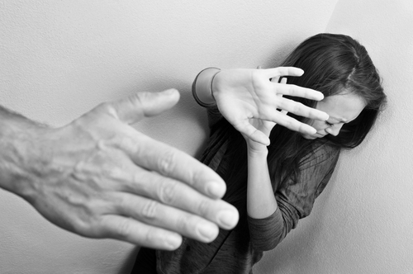
Wrong Suspect
Defend yourself by establishing that someone else was responsible for the abuse and not you.
Present evidence as to whether you were near the scene of the alleged incident and if you had a reliable alibi.

Slide 4
Self-defense
Make a claim that your action was in self-defense or to protect your children.
A claim of self defense may work if:
You reasonably perceived an imminent threat.
You had a proportional response.
You were not the initial aggressor.

Slide 5
Deliberate False Allegations
To turn away a conviction stemming from false allegations, your defense attorney will try to search for inconsistencies in the accuser’s story by comparing it to police records and witness accounts.

Slide 6
Lack of Proof
It is the strongest defense in a domestic violence case.
You cannot be convicted until and unless the prosecutor meets the requisite burden of proof.

Slide 7
Consent
Although very uncommon, if the accuser gave consent to act, that same consent may work as a defense against a domestic violence charge.

Slide 8
If you have been accused of committing an act of domestic violence, a strong domestic violence defense is essential in protecting your reputation and freedom.
Contact The Law Offices of Joel Silberman, LLC.

Slide 9
Contact Us:
The Law Offices of Joel Silberman, LLC
49 Summit Avenue
Jersey City, NJ 07306
(201)-273-7070 or (800) 889-3129
Email: joel@joelsilbermanlaw.com
www.joelsilbermanlaw.com

