Slide 1
What Happens When a Person Refuses to Take a Breathalyzer Test?

Slide 2
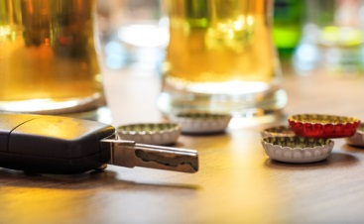
When a person is pulled over by the police on suspicion of driving under the influence (DUI), the officer may administer a field sobriety test followed by a Breathalyzer test.
A Breathalyzer test is one of the many tests used by police officers to take drivers who are suspected of driving while intoxicated into custody.

Slide 3
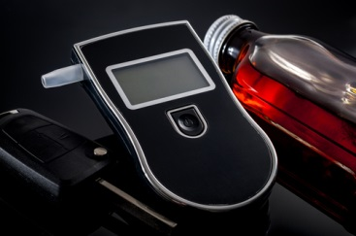
Refusing to take a Breathalyzer test can result in serious consequences.
Your driver’s license may be revoked or suspended for up to 12 months, depending on your state.
You may face heavy fines.

Slide 4
You may face a jail term for not submitting to a BAC test when suspected of a DUI.
Drivers with past DUI convictions can face even longer suspensions or jail time.

Slide 5
New Jersey has extremely tough laws relating to individuals that refuse to take a Breathalyzer test.
The consequences can have a devastating effect on a person’s career and family.
If you or a loved one has been arrested and charged with a DUI or Refusal, you should speak with attorney Joel Silberman as soon as possible to start preparing your defense.

Slide 6
Contact Us:
The Law Offices of Joel Silberman, LLC
49 Summit Avenue
Jersey City, NJ 07306
201-273-7070 or 800-889-3129
joel@joelsilbermanlaw.com
www.joelsilbermanlaw.com

