Slide 1
How a Criminal Defense Lawyer Can Help You

Slide 2
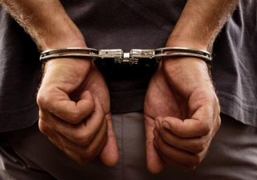
Getting charged with a crime is a serious situation.
It requires the help of an experienced and knowledgeable criminal defense lawyer.
If you or a loved one has been charged with a crime, contacting a criminal defense lawyer is vital.
Your lawyer will do the following things for you:

Slide 3
Provide you with an honest assessment
Your lawyer can provide you with an honest assessment of how the trial may go and what to expect.
File the necessary paperwork
Your lawyer can help you fill out the necessary paperwork in court.
Negotiate a plea bargain
Your lawyer can work with the prosecutor to negotiate a plea bargain for you.

Slide 4
Work out a sentencing program
Your lawyer can work out a suitable sentencing program depending on your charges.
Gather statements
Your lawyer can gather witness statements.
He or she can also hire investigators to investigate the witnesses scheduled to be presented by the prosecution.
Bring in expert witnesses to testify
A lawyer can bring in expert witnesses to testify on your behalf in an effort to get an acquittal.

Slide 5
If you are accused, charged or arrested on criminal charges, you will need an experienced and aggressive criminal defense lawyer to fight for you.
Criminal defense lawyer Joel Silberman focuses exclusively on criminal defense.
He will provide an aggressive defense from start to finish, and will keep you informed regarding your case.

Slide 6
Contact Us:
The Law Offices of Joel Silberman, LLC
549 Summit Avenue
Jersey City, NJ 07306
201-273-7070 or 800-889-3129
joel@joelsilbermanlaw.com
www.joelsilbermanlaw.com

